Slide 1
Online Shopping Website
Made by - Harsh Jain(171500120)
Naman Mittal(171500199)
Harsh Bansal(171500119)
Manish Kumar(171500180)

Slide 2
Contents
Objective
Key Features
System Requirements
Languages Used
Implementation
Conclusion

Slide 3
Objective
This online shopping site project is a general project which helps many people who want to sell their product online. Each business people can customize this program according to their requirements. This software also helps customer to find different products, their features, and new updates easily. It is designed such a way that one can view all the updates of the product from any place through online. The purpose of the system is to develop a simple Online Shopping Website and implement it, which later will be used for a web-based application.

Slide 4
Key Features
1. The system requires very fewer time factors as compared to manual system.
2. The system will provide fast and efficient automated environment instead of slow and error prone manual system.
3. The system will have GUI interface and very less user training is required to learn it.

Slide 5
System Requirements
Hardware Requirements :
1. A PC minimum of 2GB RAM
2. I3 Based Computer or Higher
Software Requirements :
1.One Text editor (VCS, Sublime, Brackets etc.)
2. WAMP Server
3. Chrome

Slide 6
Languages used
HTML
Hypertext Mark-up Language (HTML) is the standard mark up language for documents designed to be displayed in a web browser.
CSS
Cascading Style Sheets (CSS) is a style sheet language used for describing the presentation of a document written in a mark up language like HTML.
JavaScript
JS, is a high-level, interpreted scripting language. We use Java Script to define the major functionality for specific element.

Slide 7
Boot Strap 4 Bootstrap is a powerful front-end framework for faster and easier web development. It includes HTML and CSS based design templates. jQuery jQuery is an open source JavaScript library that simplifies the interactions between an HTML/CSS document, or more precisely the Document Object Model (DOM), and JavaScript. PHP Hypertext Pre-processor (or simply PHP) is a general-purpose programming language originally designed for web development.

Slide 8
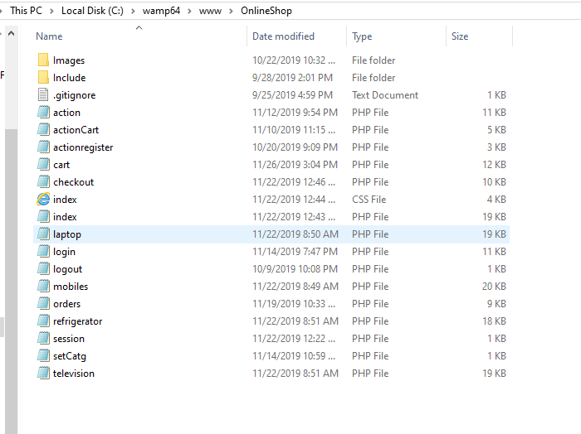
Implementation
Storing the files in Main Directory of WAMP Server

Slide 9
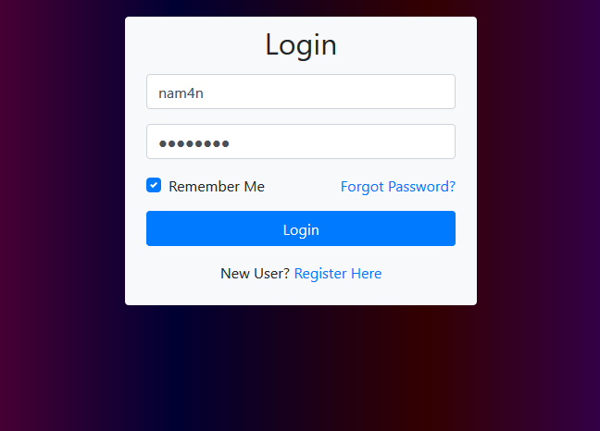
Login Page

Slide 10
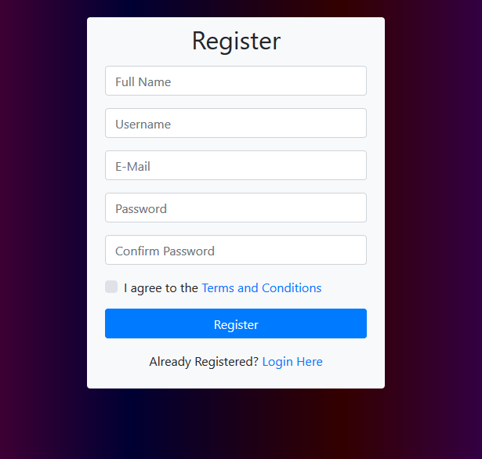
Signup Page

Slide 11
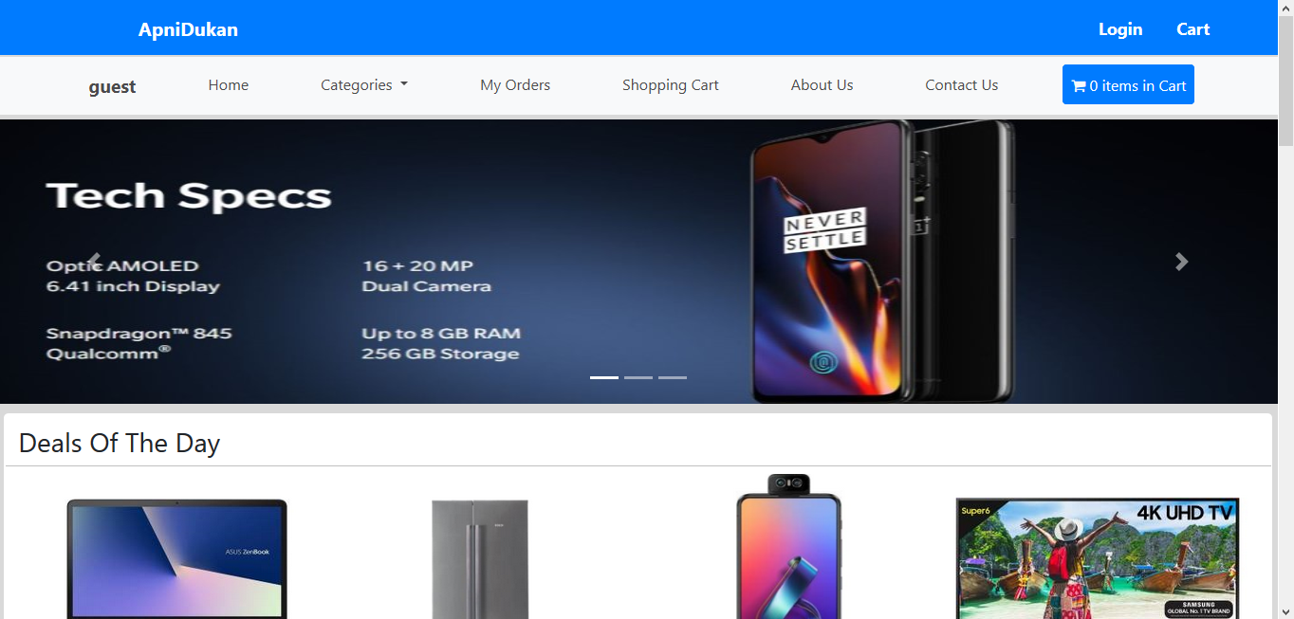
Main Page

Slide 12
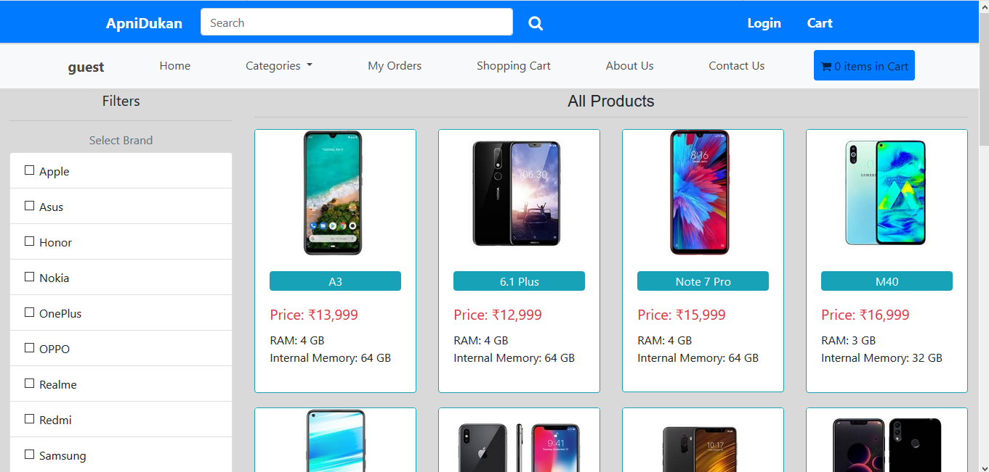
Products Page

Slide 13
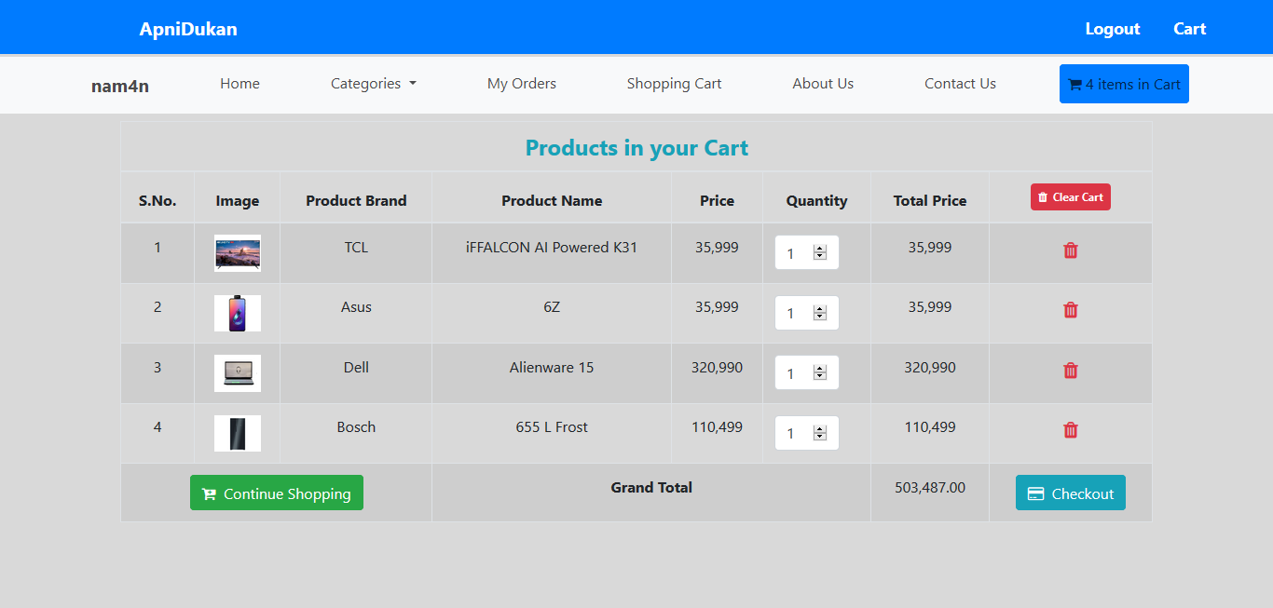
Cart page

Slide 14
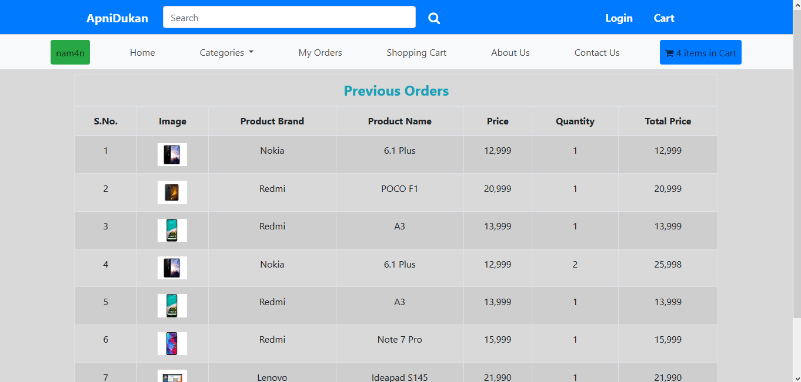
Previous Orders page

Slide 15
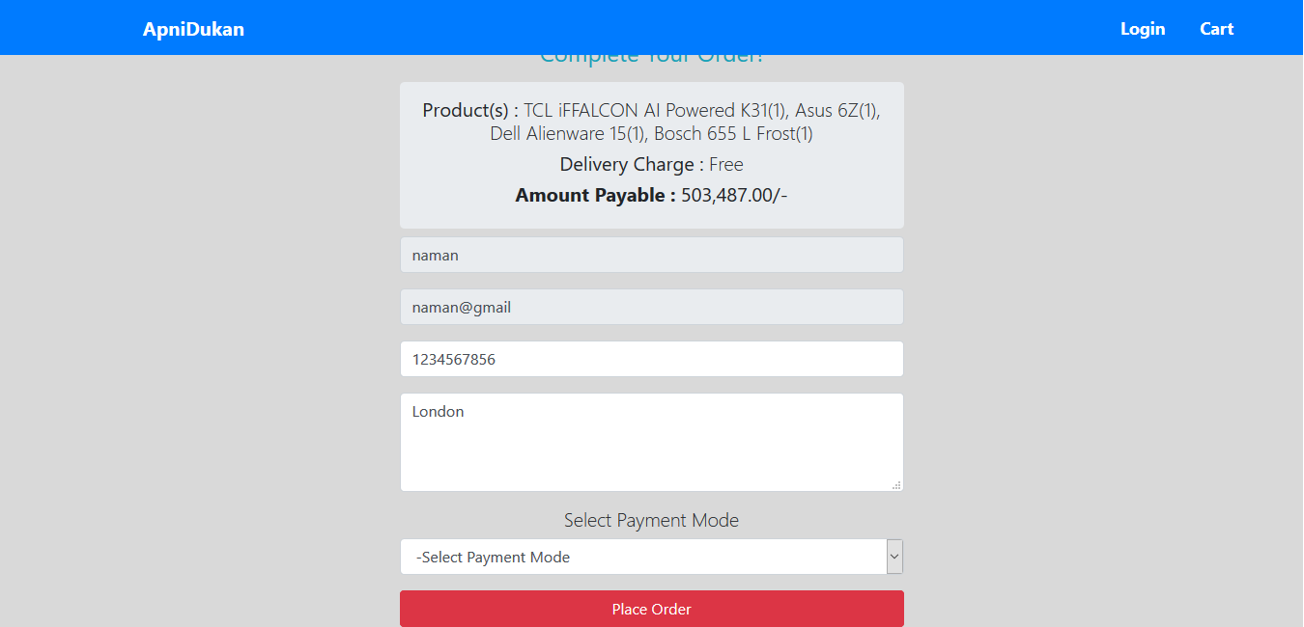
Enter details Page

Slide 16
Conclusion
After the completion of project, customer can view the all products of our Shopping Website but cannot order any item without registration. New customer can create a new account by going on sign up page. After registration, he can login and now can add any item in any quantity in the shopping cart. He can also apply different filters like price, brand, name etc. Quantity of items can be increased or decreased in the final cart page. Even he can delete any item or can clear overall cart items in one go by clicking the option clear cart. He can place the order only through cash on delivery mode. After placing the order he can view the summary with an order id which is the table number of that particular customer.

Slide 17
Bibliography
https://getbootstrap.com/
https://fontawesome.com/icons?d=gallery&s=duotone
https://api.jquery.com/category/ajax/
https://www.youtube.com/watch?v=uAslIcyd29M
https://dev.mysql.com/doc/
https://www.w3schools.com/bootstrap/bootstrap_ver.asp
https://www.javatpoint.com/phpmyadmin

Slide 18
THANK YOU

